Slide 1


NEXT GEN EMPLOYABILITY PROGRAM
CREATING A FUTURE-READY WORKFORCE
Student Name :
Bosetty Vijaya Lakshmi
Student ID :
College Name :
23KN5A0504
Nri Institute Of Technology,Agiripally.

Slide 2
CAPSTONE PROJECT SHOWCASE
Project Title
PERSONAL FINANCE MANGER.
Abstract | Problem Statement | Project Overview | Proposed Solution | Technology Used | Modelling & Results | Conclusion | Q&A

Slide 3
Abstract
1
Comprehensive Budgeting & Expense Tracking.
2
Secure & Intuitive Interface.
3
Automated Financial Planning .
4
Goal-Oriented Savings & Investment Insights.

Slide 4


Problem Statement
Many individuals struggle with managing their personal finances due to a lack of tracking, ineffective budgeting, and the complexity of financial planning. Manual methods can be time-consuming, prone to errors, and fail to provide real-time insights. This leads to overspending, missed savings opportunities, and financial stress. There is a need for a smart, automated solution that simplifies expense tracking, budgeting, and financial decision-making, helping users achieve financial stability with ease.

Slide 5

A smart and user-friendly financial tool designed to help individuals track expenses, set budgets, automate savings, and improve overall financial health. By providing real-time insights and AI-driven recommendations, the system simplifies money management, reduces financial stress, and empowers users to achieve their financial goals efficiently.
Project Overview

Slide 6
Proposed Solution
The proposed solution is a Personal Finance Manager, a smart and intuitive tool that automates expense tracking, budgeting, and financial planning. It provides real-time insights, AI-driven recommendations, and automated savings features to help users make informed financial decisions. With an easy-to-use interface, secure data handling, and personalized financial goals, the system empowers individuals to manage their money efficiently, reduce financial stress, and achieve long-term financial stability.

Slide 7
Technology used
MongoDB – NoSQL database for storing user financial data securely and efficiently.
Express.js – Backend framework for handling API requests and business logic.
React.js – Frontend library for building an interactive and responsive user interface.
Node.js – Server-side runtime environment to manage backend operations.
Mongoose – ODM (Object Data Modeling) for MongoDB to simplify database operations.

Slide 8
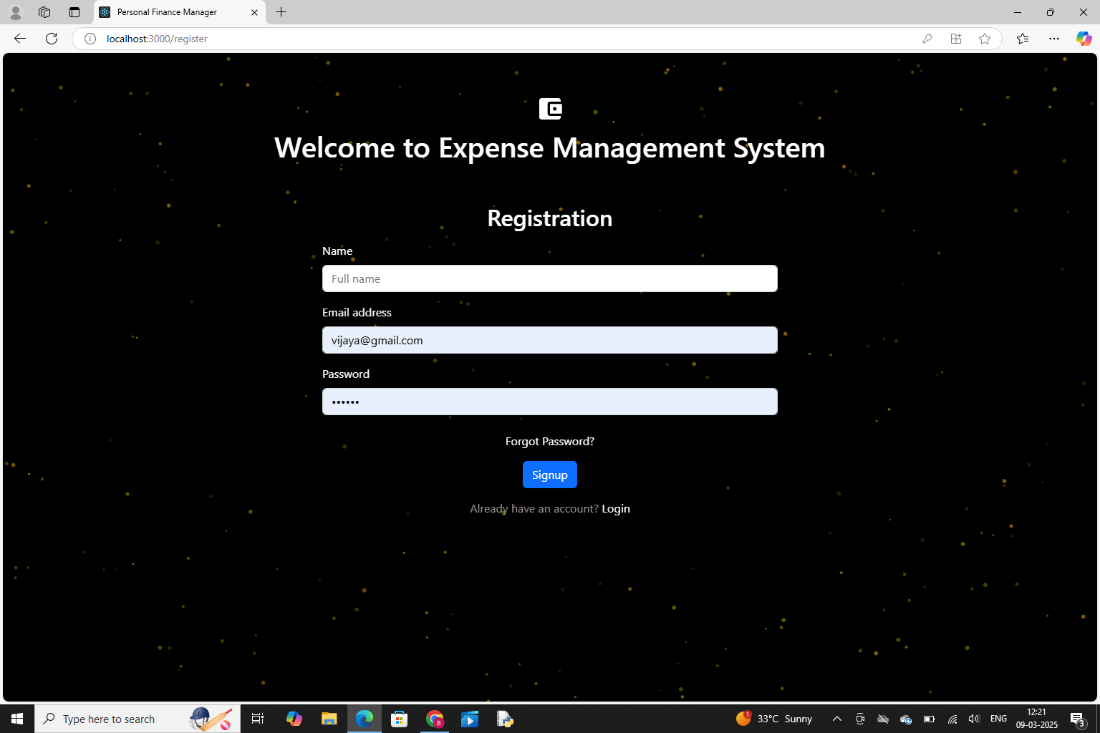
Modelling & Result

Slide 9
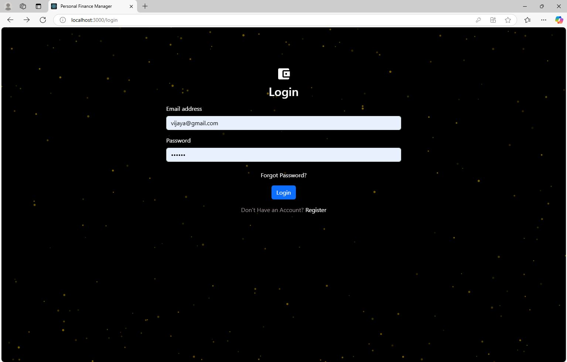
Modelling & Result

Slide 10
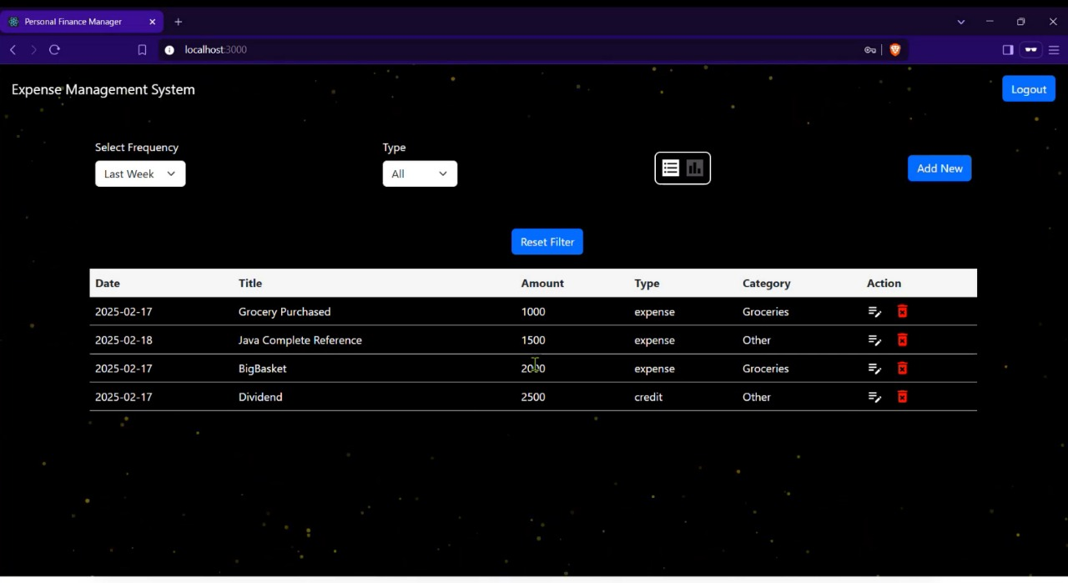
Modelling & Result

Slide 11

Conclusion
The Personal Finance Manager, developed using the MERN stack, provides an efficient and user-friendly solution for managing personal finances. With MongoDB, Express.js, React.js, Node.js, and Mongoose, it ensures secure data handling, scalability, and seamless functionality. This solution empowers users to track expenses, set budgets, and make informed financial decisions, ultimately promoting financial stability and ease of management.

Slide 12


Notes:
Thank You !!

